Slide 1
What is Freedom?
IHS Spring 2026
Feb 23 2026

Slide 2
Aneliese A.
Neil Postman's "Amusing Ourselves to Death"
"We were keeping our eye on 1984. When the year came and the prophecy didn’t, thoughtful Americans sang softly in praise of themselves. The roots of liberal democracy had held. Wherever else the terror had happened, we, at least, had not been visited by Orwellian nightmares.
But we had forgotten that alongside Orwell’s dark vision, there was another – slightly older, slightly less well known, equally chilling: Aldous Huxley’s Brave New World. Contrary to common belief even among the educated, Huxley and Orwell did not prophesy the same thing. Orwell warns that we will be overcome by an externally imposed oppression. But in Huxley’s vision, no Big Brother is required to deprive people of their autonomy, maturity and history. As he saw it, people will come to love their oppression, to adore the technologies that undo their capacities to think.
What Orwell feared were those who would ban books. What Huxley feared was that there would be no reason to ban a book, for there would be no one who wanted to read one. Orwell feared those who would deprive us of information. Huxley feared those who would give us so much that we would be reduced to passivity and egoism. Orwell feared that the truth would be concealed from us. Huxley feared the truth would be drowned in a sea of irrelevance. Orwell feared we would become a captive culture. Huxley feared we would become a trivial culture, preoccupied with some equivalent of the feelies, the orgy porgy, and the centrifugal bumblepuppy. As Huxley remarked in Brave New World Revisited, the civil libertarians and rationalists who are ever on the alert to oppose tyranny “failed to take into account man’s almost infinite appetite for distractions”. In 1984, Huxley added, people are controlled by inflicting pain. In Brave New World, they are controlled by inflicting pleasure. In short, Orwell feared that what we hate will ruin us. Huxley feared that what we love will ruin us.
This book is about the possibility that Huxley, not Orwell, was right."

Slide 3
John Stuart Mill – entry from https://plato.stanford.edu/entries/mill/
First published Thu Aug 25, 2016
John Stuart Mill (1806–73) was the most influential English language philosopher of the nineteenth century. He was a naturalist, a utilitarian, and a liberal, whose work explores the consequences of a thoroughgoing empiricist outlook. In doing so, he sought to combine the best of eighteenth-century Enlightenment thinking with newly emerging currents of nineteenth-century Romantic and historical philosophy. His most important works include System of Logic (1843), On Liberty (1859), Utilitarianism (1861) and An Examination of Sir William Hamilton’s Philosophy (1865).

Slide 4
Riten P. Mill On Liberty CHAPTER II: ON THE LIBERTY OF THOUGHT AND DISCUSSION
“Though the law of England, on the subject of the press, is as servile to this day as it was in the time of the Tudors, there is little danger of its being actually put in force against political discussion, except during some temporary panic, when fear of insurrection drives ministers and judges from their propriety; and, speaking generally, it is not, in constitutional countries, to be apprehended that the government, whether completely responsible to the people or not, will often attempt to control the expression of opinion, except when in doing so it makes itself the organ of the general intolerance of the public. Let us suppose, therefore, that the government is entirely at one with the people, and never thinks of exerting any power of coercion unless in agreement with what it conceives to be their voice. But I deny the right of the people to exercise such coercion, either by themselves or by their government. The power itself is illegitimate. The best government has no more title to it than the worst. It is as noxious, or more noxious, when exerted in accordance with public opinion, than when in or opposition to it. If all mankind minus one, were of one opinion, and only one person were of the contrary opinion, mankind would be no more justified in silencing that one person, than he, if he had the power, would be justified in silencing mankind. Were an opinion a personal possession of no value except to the owner; if to be obstructed in the enjoyment of it were simply a private injury, it would make some difference whether the injury was inflicted only on a few persons or on many. But the peculiar evil of silencing the expression of an opinion is, that it is robbing the human race; posterity as well as the existing generation; those who dissent from the opinion, still more than those who hold it. If the opinion is right, they are deprived of the opportunity of exchanging error for truth: if wrong, they lose, what is almost as great a benefit, the clearer perception and livelier impression of truth, produced by its collision with error. It is necessary to consider separately these two hypotheses, each of which has a distinct branch of the argument corresponding to it. We can never be sure that the opinion we are endeavouring to stifle is a false opinion; and if we were sure, stifling it would be an evil still.”

Slide 5
Mill: other passages to look at
Introductory
…The object of this Essay is to assert one very simple principle, as entitled to govern absolutely the dealings of society with the individual in the way of compulsion and control, whether the means used be physical force in the form of legal penalties, or the moral coercion of public opinion. That principle is, that the sole end for which mankind are warranted, individually or collectively, in interfering with the liberty of action of any of their number, is self-protection. That the only purpose for which power can be rightfully exercised over any member of a civilised community, against his will, is to prevent harm to others. His own good, either physical or moral, is not a sufficient warrant. He cannot rightfully be compelled to do or forbear because it will be better for him to do so, because it will make him happier, because, in the opinions of others, to do so would be wise, or even right. These are good reasons for remonstrating with him, or reasoning with him, or persuading him, or entreating him, but not for compelling him, or visiting him with any evil in case he do otherwise. To justify that, the conduct from which it is desired to deter him must be calculated to produce evil to some one else. The only part of the conduct of any one, for which he is amenable to society, is that which concerns others. In the part which merely concerns himself, his independence is, of right, absolute. Over himself, over his own body and mind, the individual is sovereign.

Slide 6
CHAPTER V: APPLICATIONS
“The maxims are, first, that the individual is not accountable to society for his actions, in so far as these concern the interests of no person but himself. Advice, instruction, persuasion, and avoidance by other people if thought necessary by them for their own good, are the only measures by which society can justifiably express its dislike or disapprobation of his conduct. Secondly, that for such actions as are prejudicial to the interests of others, the individual is accountable and may be subjected either to social or to legal punishments, if society is of opinion that the one or the other is requisite for its protection.”
EXAMPLES:
Free Trade
Poisons
Drinking
Idleness
“Drunkenness, for example, in ordinary cases, is not a fit subject for legislative interference; but I should deem it perfectly legitimate that a person, who had once been convicted of any act of violence to others under the influence of drink, should be placed under a special legal restriction, personal to himself; that if he were afterwards found drunk, he should be liable to a penalty, and that if when in that state he committed another offence, the punishment to which he would be liable for that other offence should be increased in severity. The making himself drunk, in a person whom drunkenness excites to do harm to others, is a crime against others.”

Slide 7
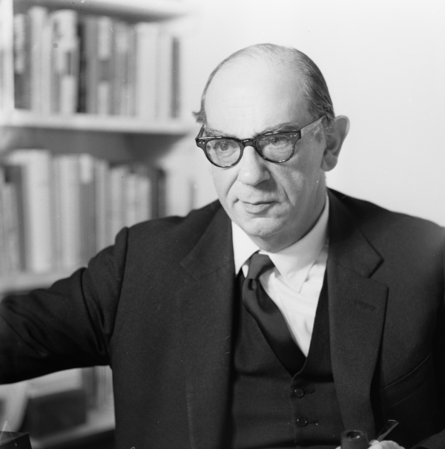
Isaiah Berlin
b. 1909 Riga (now the capital of Latvia)
d. 1997 Oxford, UK
Witnessed Russian Revolutions of 1917 in Petrograd
Family emigrated in 1921, to Britain
Attended Oxford
Appointed to lectureship at New College (Oxford) in 1932
Became the first Jew to be elected to a Prize Fellowship at All Souls, Oxford
During WWII served in British Inforation Services in New York; at British Embassy in D.C.
1945-46 visited the Soviet Union, met with Anna Akhmatova and Boris Pasternak – these meetings influenced his future research.
Source: Stanford Encyclopedia of Philosophy
https://plato.stanford.edu/entries/berlin/ Highly recommend!

Slide 8
“The Concept of Liberty”
What is negative liberty?
“freedom from, the absence of constraints on the agent imposed by other people”
Associated with liberal tradition
What is positive liberty?
“freedom to, that is, the ability (not just the opportunity) to pursue and achieve willed goals; also autonomy or self-rule, as opposed to dependence on others. These are not the same”
traces back to Rousseau, who had “equated freedom with self-rule, and self-rule with obedience to the so-called ‘general will.’ By this, Berlin alleged, Rousseau meant, essentially, the common or public interest – that is, what was best for all citizens qua citizens.”
This view clashed with Berlin’s.
Problems: when the group decides what is best for the individual
(Stanford Encyclopedia)

Slide 9
Breakout Rooms
THE NOTION OF NEGATIVE FREEDOM
Group 1: p. 172-173 of Berlin
How does Berlin differentiate freedom from justice and inequality? What kind of “confusion of values” does he try to explain? How does he back up the claim that “the freedom of some must at times be curtailed to secure the freedom of others”? Can you think of contemporary situations where this dynamic is at play?
Group 2: p. 174-5 of Berlin
How does Berlin explicate Mills’s idea of individual liberty? That is, what would be lost if individuals become too constrained by the collective? Do you see any overlap with the ideas from Nietzsche’s essay were were discussing last week?
Group 3: p. 177-8
Why is negative freedom not necessarily connected to democracy or self-government? How do you make sense of this claim that autocrats can allow their subjects a wide area of liberty?

Slide 10
THE NOTION OF POSITIVE FREEDOM
GROUP 1
p. 179 how does the notion of positive freedom rest upon the concept of the self? How has the self been understood in the tradition of liberal individualism? What are the “perils of organic metaphors”?
GROUP 2
p. 180-1: examine Berlin’s statement that “This monstrous impersonation, which consists in equating what X would choose if he were something he is not, or at least not yet, with what X actually seeks and chooses, is at the heart of all political theories of self-realization.”
GROUP 3
p. 182-183 What does Berlin call the “retreat to the inner citadel”? How does Kant define freedom, according to Berlin? How does this definition relate to Rousseau’s, on p. 186? If you like, consider the end of this section, too, on the critique of negative liberty “as the ability to do what one wishes.”

Slide 11
Look together at p. 199-200
And in particular, look at the rehearsal in four steps – how despotism can be made identical to freedom.
Other questions:
p. 201-2 What is the importance of social status, social networks, for the implications of freedom for the individual? Or for critiques of Mill?
p. 207: “No society literally suppresses all the liberties of its members; a being who is prevented by others from doing anything at all on his own is not a moral agent at all, and could not either legally or morally be regarded as a human being…”
p. 211-212: “But if democracies can, without ceasing to be democratic, suppress freedom, at least as liberals have used the word, what would make a society truly free?”
Look at the 2 points here.

Slide 12
The one and the many:
p. 213
“One belief, more than any other, is responsible for the slaughter of individuals on the altars of the great historical ideals” – what is this?
p. 214: key: there is no harmony – therefore, choice is necessary

